Slide 1
Revenue Growth & Churn Analysis
End-to-End Analytics Project ( SQL . Python . Power BI)
Business wanted to understand how revenue has evolved over time.
Concern around revenue stability and customer churn.
Analysis performed on historical transactional data
Goal : Understand Revenue trends, identify risk areas, and guide future decisions.
By
Monisha Chaluvadi

Slide 2
How the Analysis Was Done
SQL: Used to extract, clean, and aggregate transactional data to calculate revenue and customer-level metrics.
Python: Used for exploratory analysis and validation to ensure trends and metrics were consistent.
Power BI: Used to model data, calculate business KPIs, and build interactive dashboards for decision-making.

Slide 3
Key Questions We Answered
This analysis focused on four core questions:
How is revenue trending over time?
Is revenue growth consistent or volatile?
Which customer segments drive revenue?
How much revenue is impacted by churn?

Slide 4
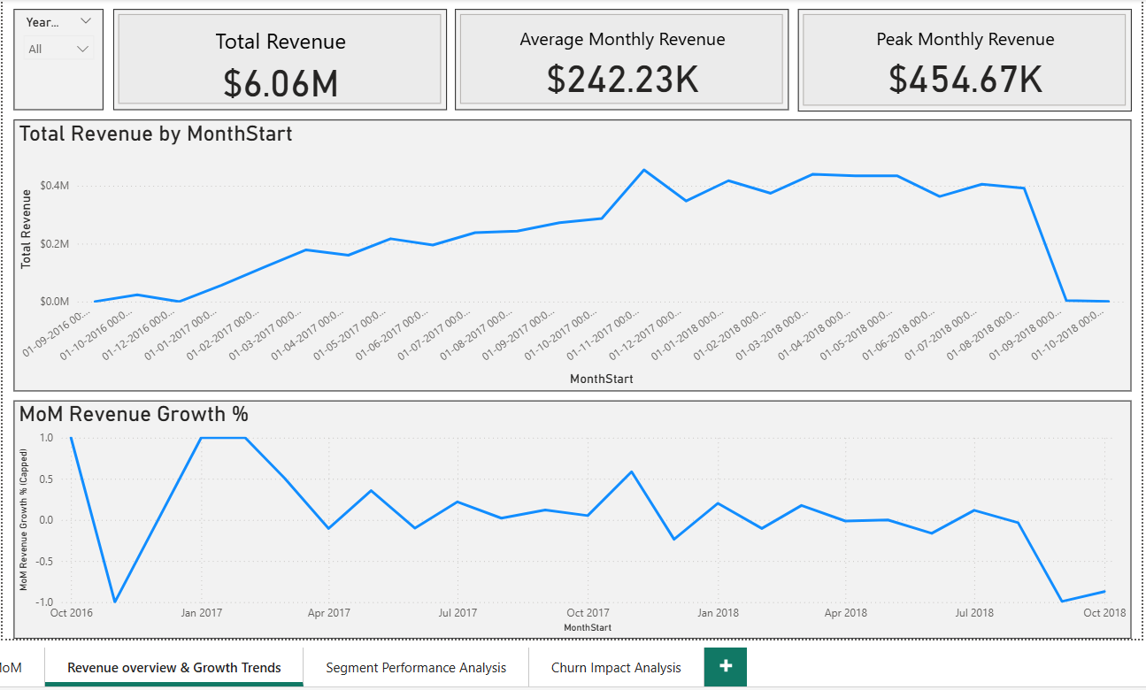
What We Observed (Revenue Trends):
Key observations:
Revenue growth is not linear.
Certain months show strong growth followed by slowdowns.
Recent revenue depends heavily on a limited number of periods.
What this means:
Growth is periodic, not stable. Business is exposed to sudden downturns.

Slide 5
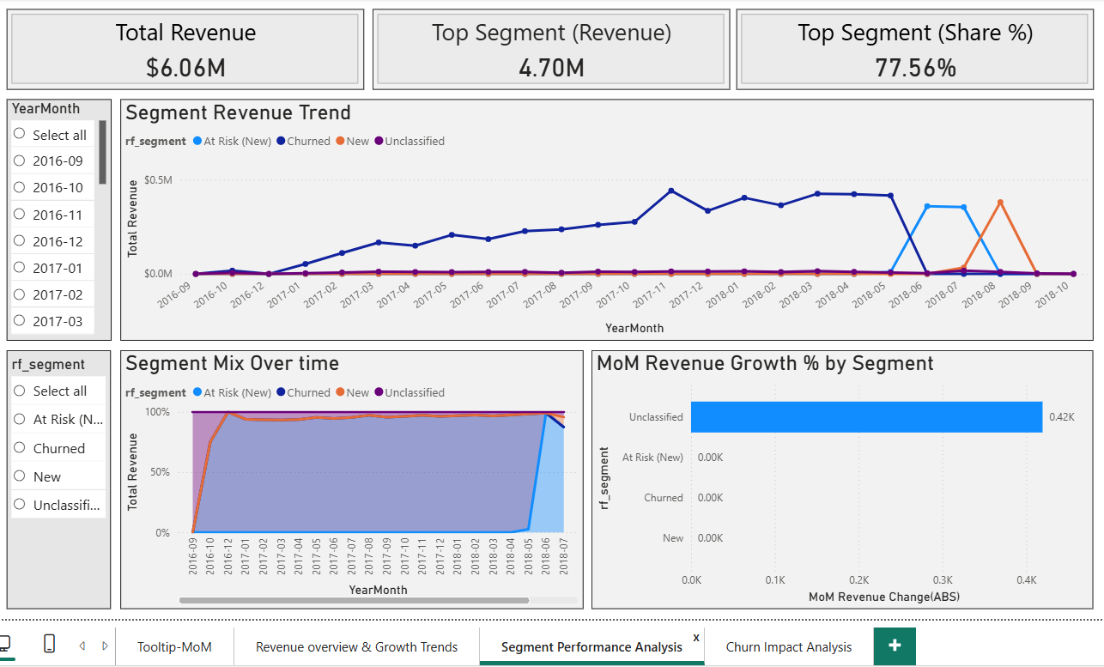
What’s Driving Revenue (Segments):
Key observations:
A small number of customer segments contribute most revenue.
Some segments grow faster but are less predictable.
Revenue concentration increases business risk.
What this means:
Over-reliance on specific segments. Need to protect high-value segments

Slide 6
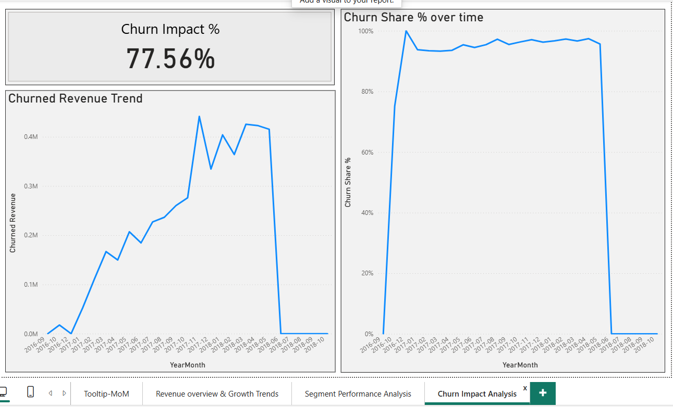
Churn Impact on Revenue:
Key observations:
Churned customers account for a significant share of lost revenue.
Churn occurs in clusters, not randomly.
Revenue declines often follow churn spikes.
What this means:
Churn is structural, not occasional. Revenue loss is preventable with early action.

Slide 7
Business Takeaways & Next Actions:
Key takeaways:
Revenue growth is fragile without churn control.
Retention has higher impact than acquisition alone.
Early signals exist before revenue declines.
Recommended actions:
Monitor month-over-month revenue changes closely.
Focus retention efforts on top revenue segments.
Investigate drivers behind churn-heavy periods

Slide 8
Thank You
Thank you for listening.
I look forward to your questions.

